Slide 1
Applying statistics to predict the popularity of TED Talks
Imane HOUMIR
2018-2019

Slide 2
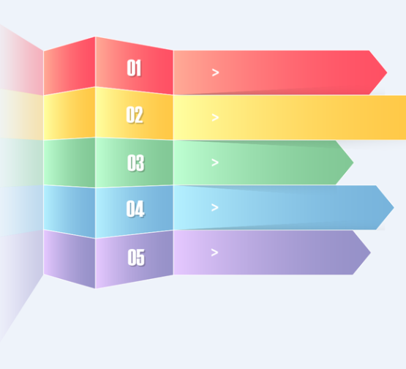

SUMMARY
Project approach
Dataset Description
Modelling methodology
Data Analysis & Implementation
Results

Slide 3
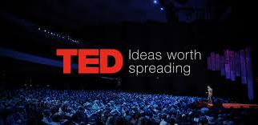
INTRODUCTION
TED is a nonpartisan and non-profit organization. TED spreads ideas, primarily via short talks that can be accessed on the internet. As noted on its website, TED was initiated in 1984 as a conference where technology, entertainment, and design ideas were shared. At present, TED Talks cover topics ranging from science to business to global issues

Slide 4
Project approach
Background:
This case study will discuss the popularity of Ted talks by measuring the relationships between the features available. Using statistical modelling will allow the building of models and assess the best model.
Statistical problems identified:
Which characteristics are strongly associated with high number of views?
Objectives:
The aim of this analysis is to explore which variables are strong predictors of TED’s popularity
Finding insights about the world of TED, its speakers and its viewers

Slide 5
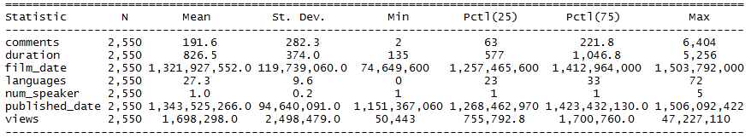
Dataset Description
Content & aknowledegement:
These datasets contain information about all audio-video recordings of TED Talks uploaded to the official TED.com website until September 21st, 2017. The data has been scraped from the official TED Website and uploaded on Kaggle.com website.
Descriptive statistics using RStudio:
Number of Records: 2550
Number of Columns: 17
Features available:

Slide 6
Modelling methodology
This case study analysed and explored the data using statistical techniques to measure the relationship between number of views and the other features of data.
For this reason, the first step will be calculation the correlation to show wheter and how strongly these pairs of variables are related.
The second step will be using regression analysis to infer causal relationships between the views and the other variables.The regression analysis includes both linear and multiple regression.
The multiple regression will build different models that will be assessed to choose the best scenario of association.

Slide 7
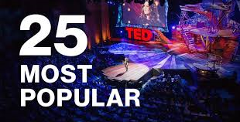
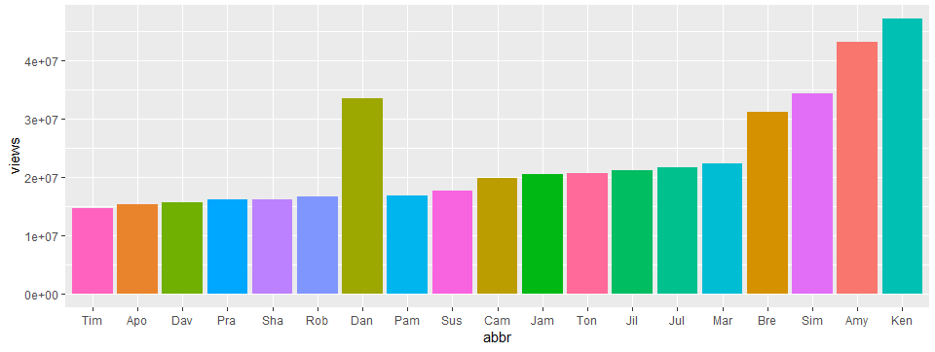
Data analysis & Implementation
This section will highlight some insights from data before measuring the best association of variables that can predict the popularity of TED talks.
The top 20 popular TED talks:
Observations:
Ken Robinson's talk: Do Schools Kill
Creativity? is the most popular
TED Talk of all time with 47.2 million views.
Followed by Amy Cuddy's talk:
Your Body Language May Shape Who You Are.

Slide 8
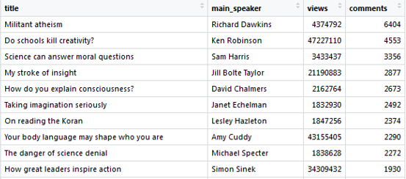
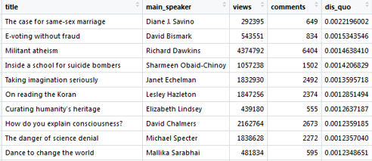
The most viewed and commented TED talks:
Observation:
Richard Dawkins' talk on Militant Atheism’ collected
the greatest amount of discussion despite having
lesser views than Ken Robinson's talk, which is
second in the list.
Which talks theme tend to attract the largest amount of discussion?
By calculating the ratio of the number of comments to the number of views
Observations:
The most discussed is The Case for Same Sex Marriage.
Half of the talks in the top 10 are about
Faith and Religion, and science

Slide 9
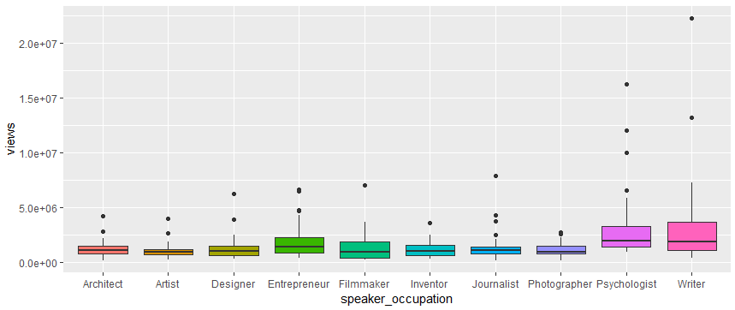
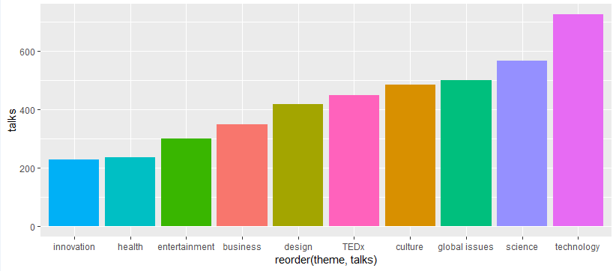
Which occupation should you choose if you want to become a TED Speaker?
Observation:
On average, out of the top 10 most popular professions, Psychologists tend to garner the most views. Writers have the greatest range of views between the first and the third quartile
what are the most popular themes in the Ted talks:
Observation:
Technology is the most popular topic for talks. Science and Global Issues are the second and the third most popular themes respectively.

Slide 10
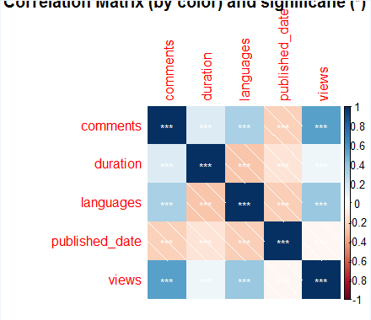
Correlation matrix
Observation:
The correlation matrix shows us the following observations:
There is a relatively higher positive correlation between number of comments and views, which makes sense (more audience, more comments)
Some positive correlation between number of languages of translation and number of views (0.38) and number of comments (0.32)
Small negative correlation between duration and number of languages; the shorter the talk, the more translated languages there are, probably because it is easier to translate.

Slide 11
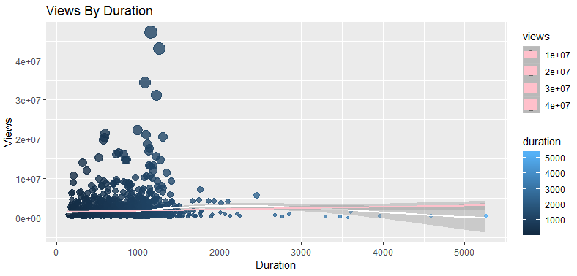
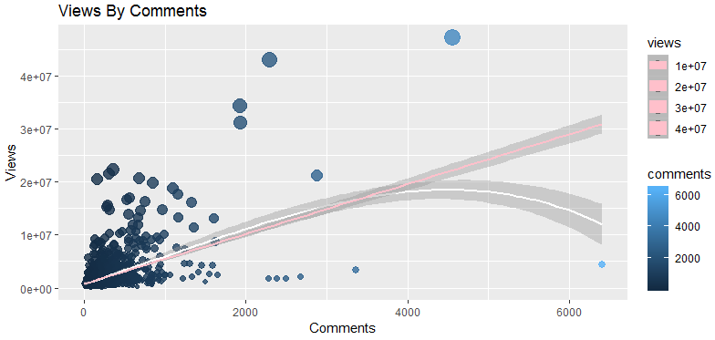
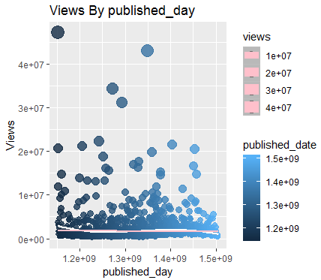
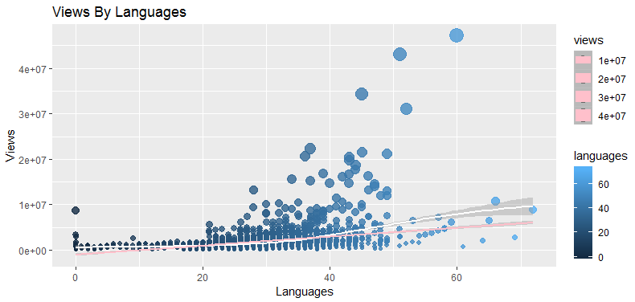
Correlation Of Parameters with Numbers of Views
Observation:
with LOESS flexible regression in white and linear regression in pink, to see how different would a linear shape look from a flexible moving average. This shows us that usually, except for in the tales of the distributions of these variables, where there are only a couple of outliers’ data, the linear model described the relationship somewhat well. Therefore, inputting the regressor as a linear fit might be sufficiently explanatory.

Slide 12
Individual regression Models
This section presents the assessment of how does each of the relevant variables explain the count individually, and how does then adding one to a multiple regression improves its performance.
Models:
Model1 = views ~ comments
Model2 = views ~ languages
Model3 = views ~ duration
Model4 = views ~ published_date
Model5 = views ~ speaker_occupation
Model6 = views ~ theme

Slide 13
Multiple regression Models
Model7 = views ~ comments + languages
Model8 = views ~ comments + languages + duration
Model9 = views ~ comments + languages + duration + published_date
Model10 = views ~ comments + languages + duration + published_date + speaker_occupation
Model11 = views ~ comments + languages + duration + theme

Slide 14
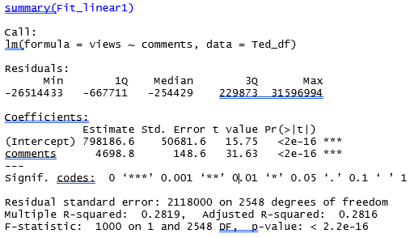
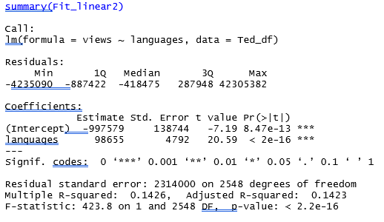
Results :Individual Regression
Findings:
The comments and languages where significantly and positively correlated with views.
One unit comment increase, is the increase the number of views to 4698.8 (Slope)
One new language translation, is the increase of the number of views to 98655

Slide 15
Results : Multiple regression Models
the best performance out of this set of models are shown in these tables.
The model 7: it is suitable for explanatory purposes. Comments and languages are so far the most correlated variables with views and explain most of its variance.
The Model 11: it is suitable for prediction purposes, it uses all the set of variables.
In this model the views are dependent on comments, languages translated, duration and theme.

Slide 16
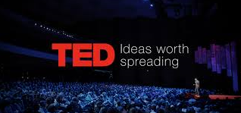
CONCLUSION
To conclude the model is limited and does not convey causal relationship because the fundamental problem of causal inference is not well addressed with these variables, and these predictors are not independent from the y variable.
As a further areas of research, might use the transcript of the talk to analyze the content.
Finally, one can see some correlations, even if not causal. Higher number of views for a talk, it would be likelier if: Increase the number of comments increases in a talk! Increase the languages translated! There is no need to make it too short! (probably only works if the talk is really good) Tag it with more topics!

